Slide 1

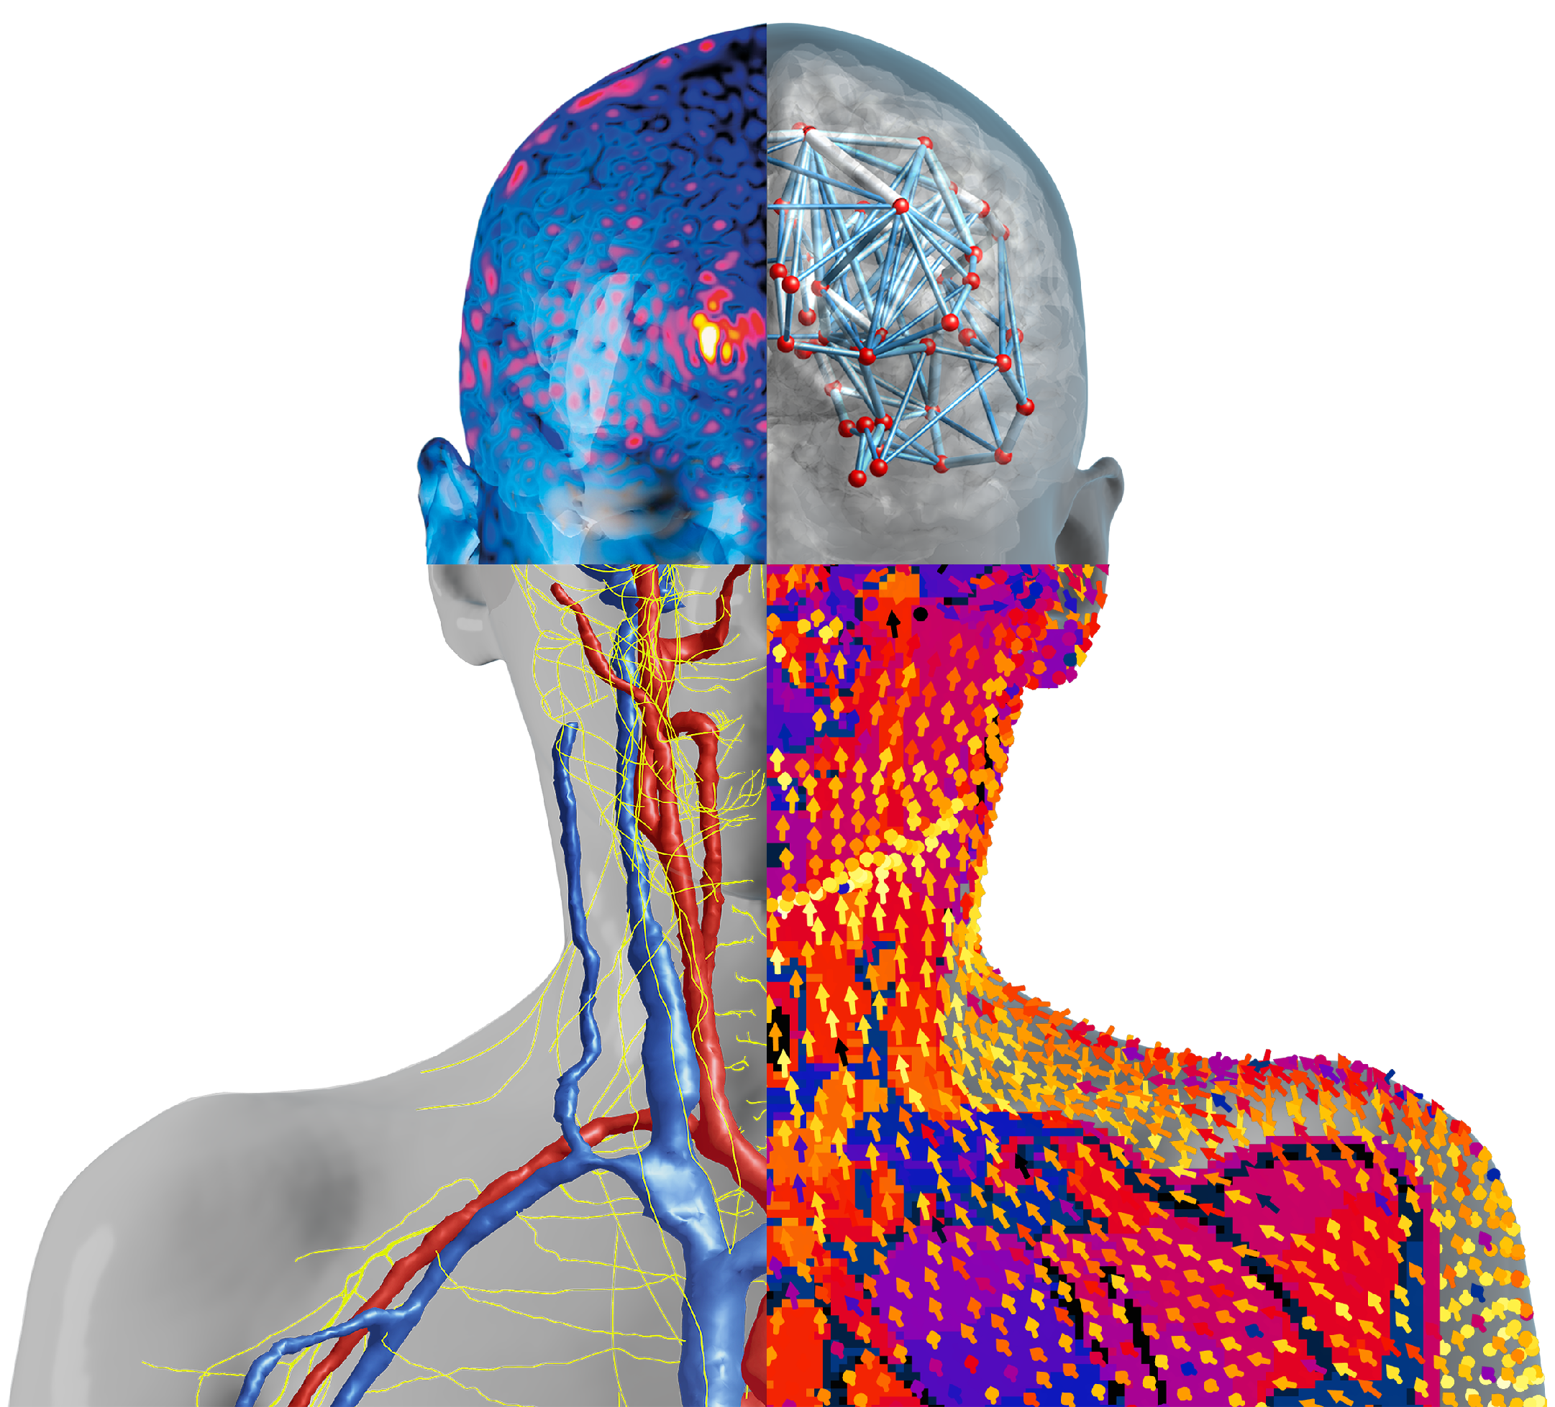


Introducing MetaModeling UX
Javier Garcia Ordonez, IT’IS Foundation & ZMT
Werner Van Geit, IT’IS Foundation
Esra Neufeld, IT’IS Foundation

Slide 2

Content
Background & Objectives
Setup & Surrogate Model Building
Example Applications
Next Steps
Conclusions
Introducing the MetaModeling UX, Zürich, 2025

Slide 3
Background & Objectives
Introducing the MetaModeling UX, Zürich, 2025
Introducing the MetaModeling UX, Zürich, 2025
Compliance Evaluations of Inductive WPT, Okinawa, 2024

Slide 4

What is MMUX?
meta-modeling
meta-modeling is an abstraction of a model to highlight its properties
involves the generation of a surrogate model which mimics the input-output relationships of the original model while being much faster/cheaper computationally
MMUX: Meta-Modeling User eXperience
streamlined meta-modeling workflows for real-world applications
automated construction and validation of surrogate models
native integration with OSPARC pipelines and Sim4Life projects
cloud-based scalability
Introducing the MetaModeling UX, Zürich, 2025
Introducing the MetaModeling UX, Zürich, 2025
Notes:
e.g. people have the modeling knowledge – bring them the meta-modeling UX to plug on top in an intuitive way, and get much more insight, design, etc out of their models. More value for them, using our modeling tools. And many more simulations so we get much more money.

Slide 5
Why MMUX?
meta-modeling enables next-generation in-silico trials
all enabled by our cloud computing infrastructure for scalability and accessibility
easy-to-use HyperTools for real-world problems
explore model variability & uncertainty
extensive risk assessment, detection of safety violation conditions
performance optimization
model-based real-time control
Introducing the MetaModeling UX, Zürich, 2025
Introducing the MetaModeling UX, Zürich, 2025
Notes:
e.g. people have the modeling knowledge – bring them the meta-modeling UX to plug on top in an intuitive way, and get much more insight, design, etc out of their models. More value for them, using our modeling tools. And many more simulations so we get much more money.

Slide 6
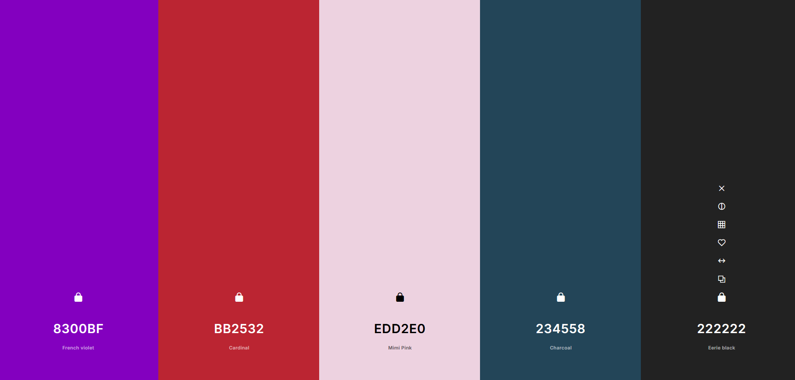

Slide 7
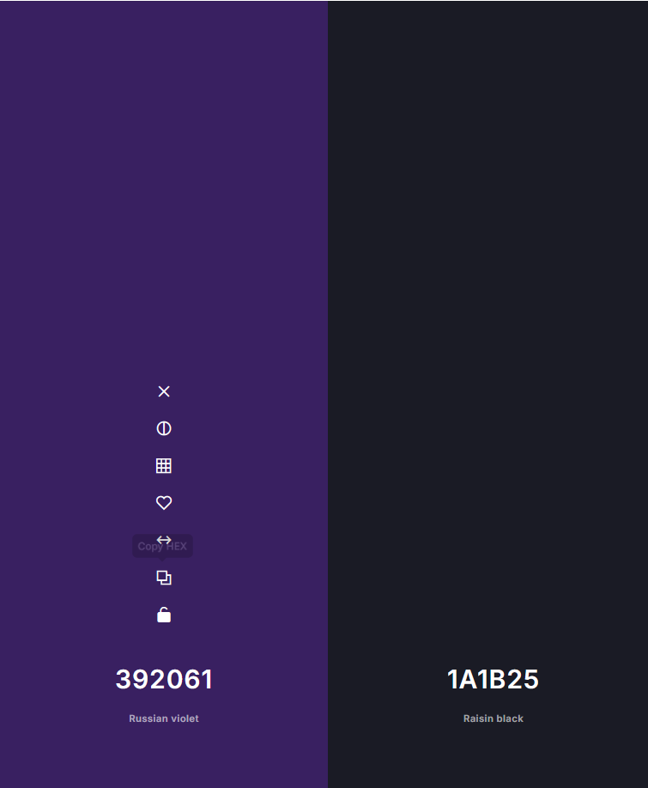
Background options (in all of them)

Slide 8
Metamodelling Functions API
Introducing the MetaModeling UX, Zürich, 2025
Introducing the MetaModeling UX, Zürich, 2025
Compliance Evaluations of Inductive WPT, Okinawa, 2024

Slide 9
Metamodelling Functions API
Allow the users of oSPARC / Sim4Life to build a library of functions. Each function accepts some parameters and returns quantities of interest
Functions could be:
oSPARC studies
oSPARC solvers
Sim4Life espresso runs
Python scripts
etc.
Introducing the MetaModeling UX, Zürich, 2025

Slide 10
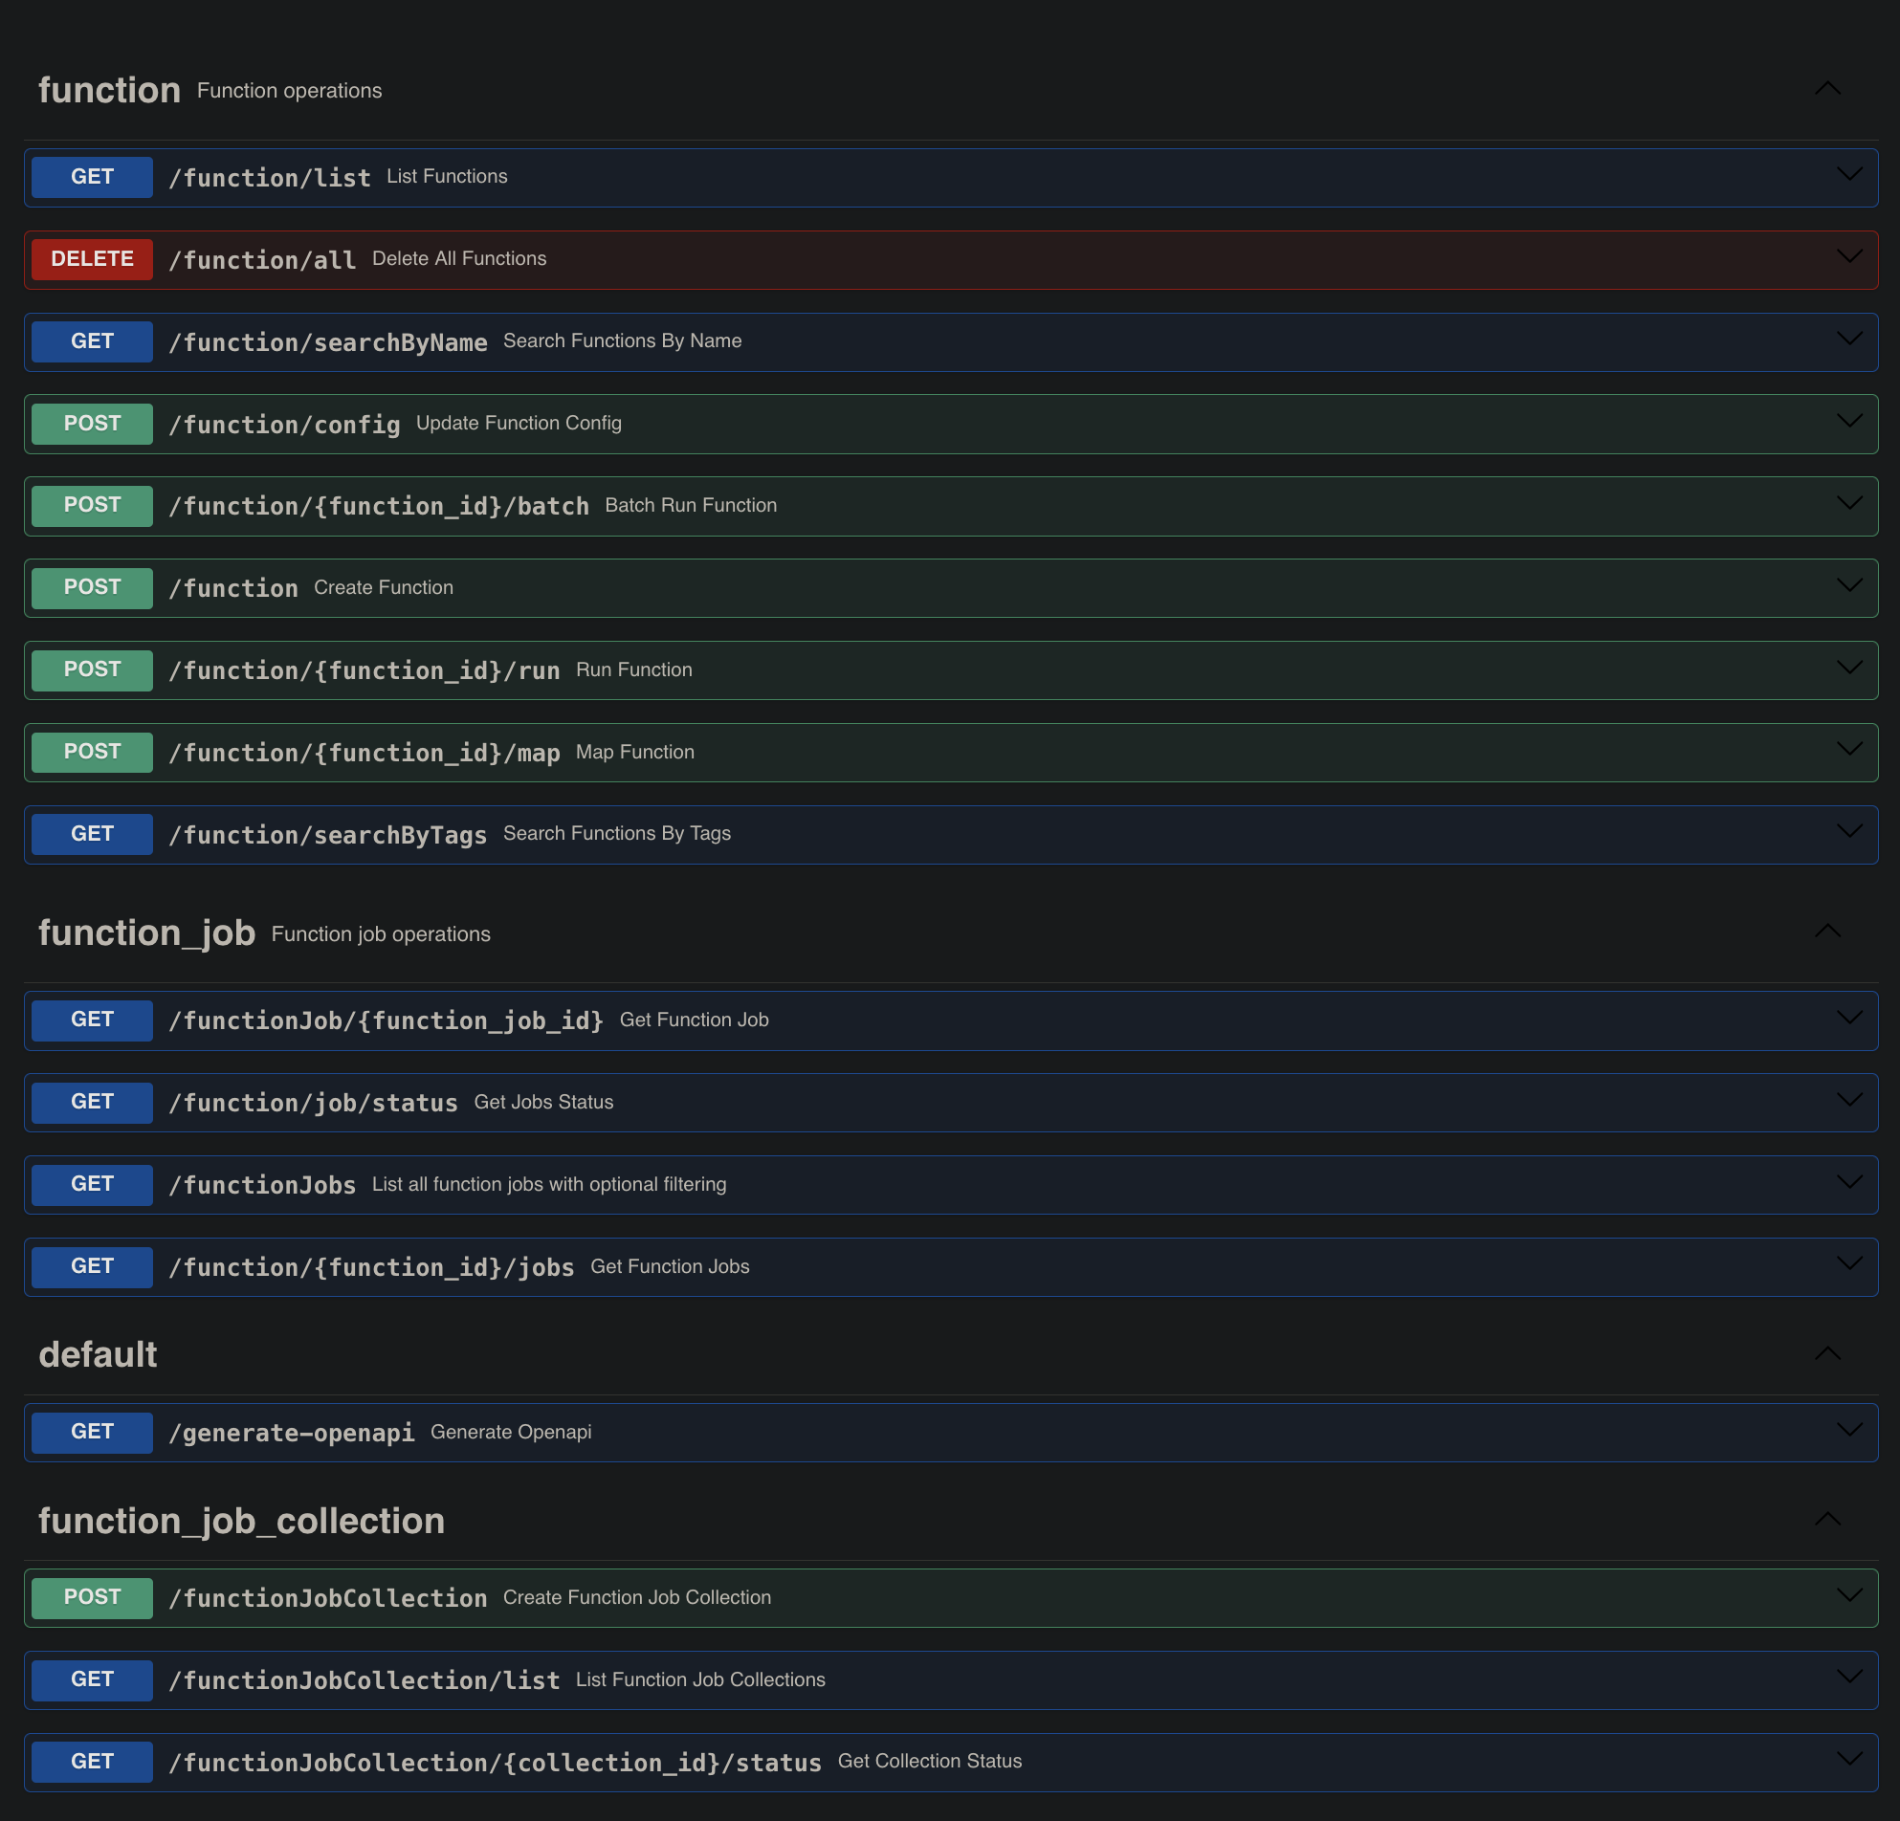
Metamodelling Functions API
The oSPARC API will provide functionality to store, list, run, … functions
Introducing the MetaModeling UX, Zürich, 2025

Slide 11
Setup & Surrogate Model Building
Introducing the MetaModeling UX, Zürich, 2025
Introducing the MetaModeling UX, Zürich, 2025
Compliance Evaluations of Inductive WPT, Okinawa, 2024

Slide 12







Setup
MetaModeling UX - Setup
Inputs:
input 1 : type …
input 2 : type …
Function Selector:
Outputs
output 1 : type …
output 2 : type …
Optional: test your function
Inputs:
parameter 1 (min – max)
parameter 2 (cat1, cat2, …)
… link-to-instantiated-template
Outputs:
output 1: …
output 2: …
(if SuMo variant) Sampling
Number of Samples to build the SuMo:
Sampling Method: seed:
Sampling variables: l-bound h-bound
parameter 1 -
parameter 2 -
…
Introducing the MetaModeling UX, Zürich, 2025
Number of Samples to build the SuMo:
Notes:
There would be SuMo and non-SuMo variant.

Slide 13
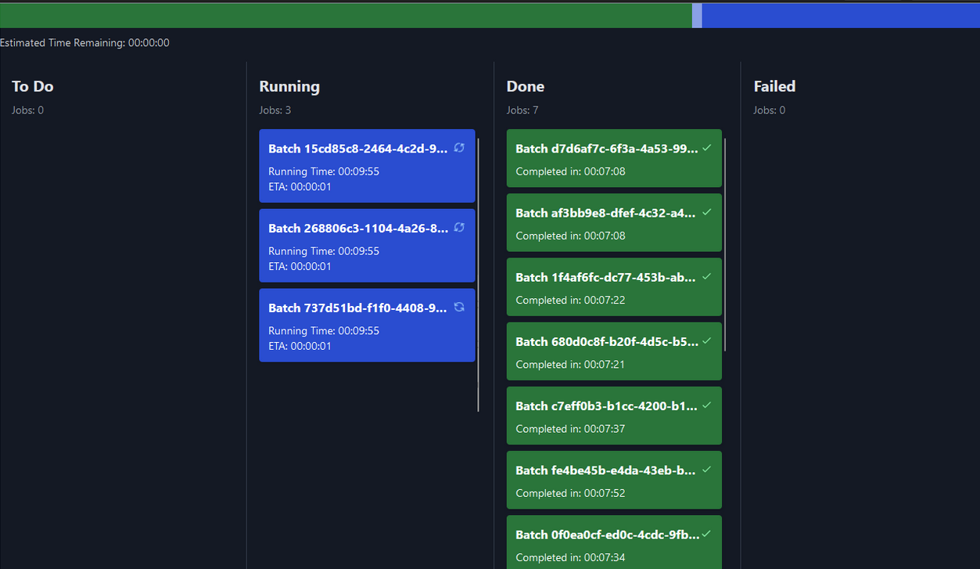

Setup
MetaModeling UX - Setup
Inputs:
input 1 : type …
input 2 : type …
Function Selector:
Outputs
output 1 : type …
output 2 : type …
Optional: test your function
Inputs:
parameter 1 (min – max)
parameter 2 (cat1, cat2, …)
… link-to-instantiated-template
Outputs:
output 1: …
output 2: …
(if SuMo variant) Sampling
Number of Samples to build the SuMo:
Sampling Method: seed:
Sampling variables: l-bound h-bound
parameter 1 -
parameter 2 -
…
Introducing the MetaModeling UX, Zürich, 2025
Number of Samples to build the SuMo:
Notes:
When running, would change to Orange.

Slide 14


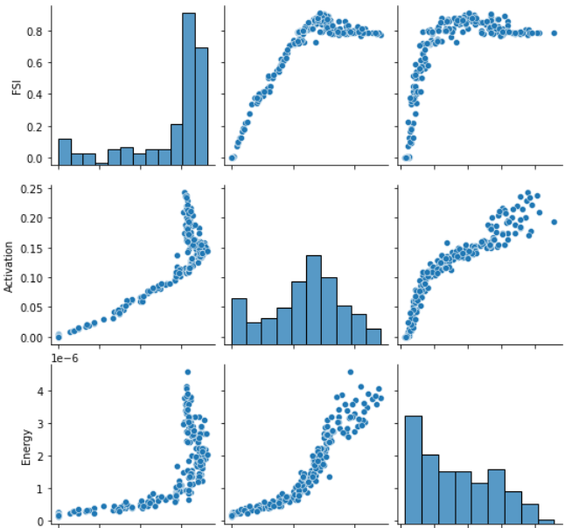
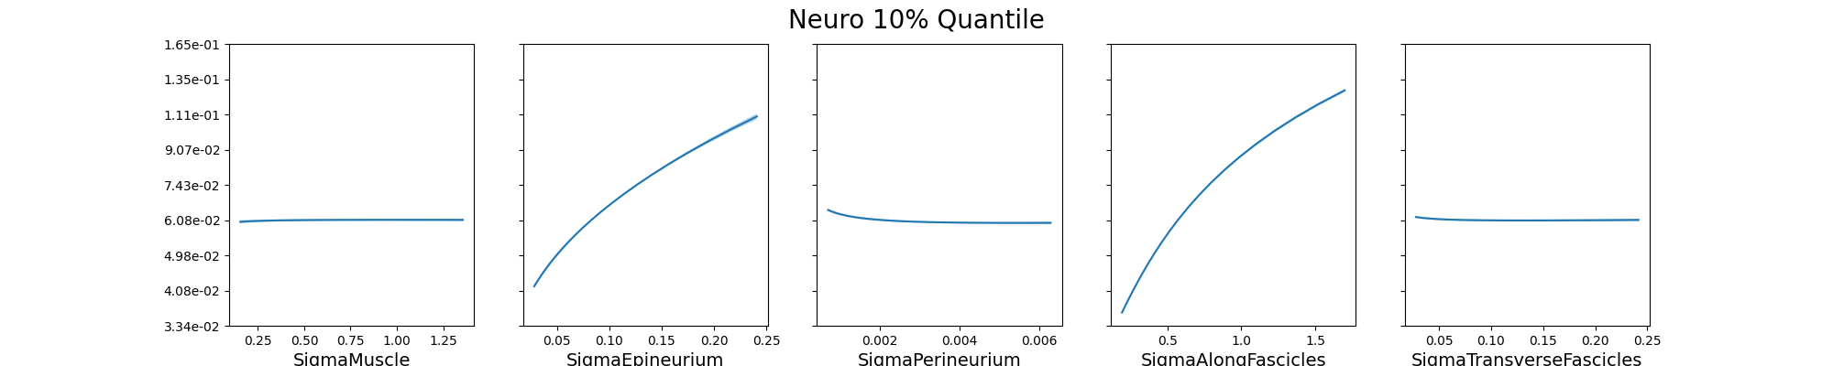
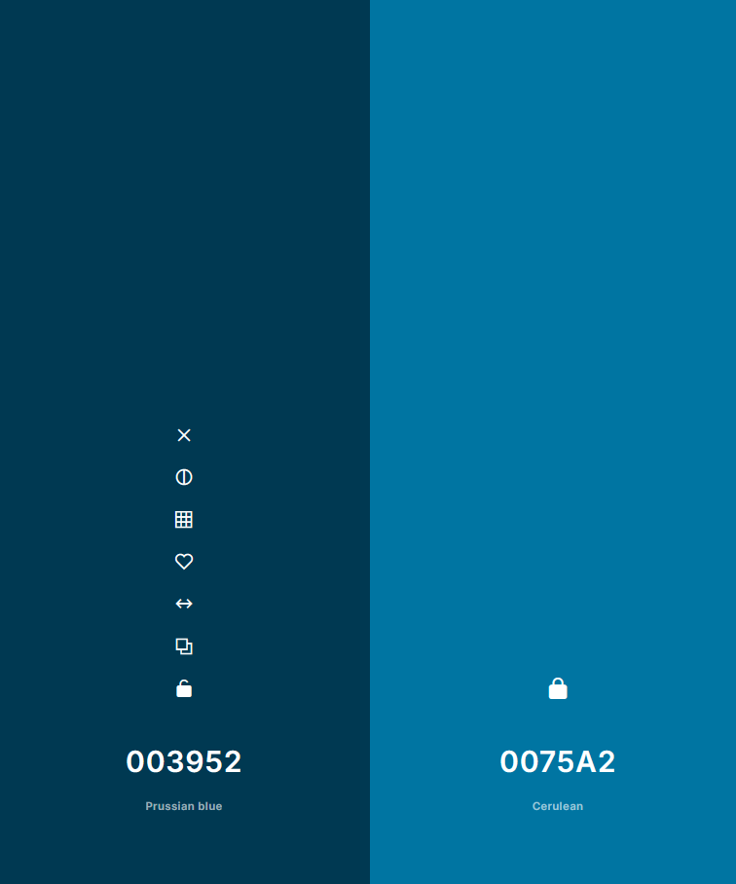
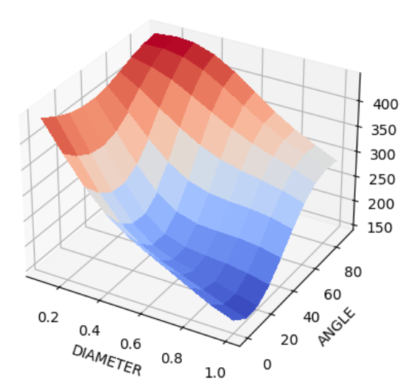
Surrogate Model Building (Optional)
MetaModeling UX - Surrogate Model Building & Validation
Sampling:
collection of jobs. Automatically takes last run from previous screen; can choose a different one if desired, and inspect the values (e.g. inputs & outputs) in a TableViewer; visualize as pairplot
Surrogate Model:
Surrogate Model Analysis and Validation
Output QoI model:
Samples pairplot
Cross-Validation Metrics
RMSE x.xxx
MAE x.xxx
STD x.xxx
Response Curve Inspection
Response Plane Inspection
Introducing the MetaModeling UX, Zürich, 2025
Notes:
At some point, offer users to save & register (collection of) SuMo. To be used as a function in next steps.
The modular section with diff analysis could also be a module, act as a toggle, and a new one / a duplication can be created for another QoI ?

Slide 15



Uncertainty Quantification
Number of Samples: seed:
Inputs:
parameter 1 mean: std:
parameter 2 min: max:
…
MetaModeling UX - Uncertainty Quantification
Function Selector:
Automatically SuMo from previous screen (or function if no SuMo). But can ofc be changed by user.
once sampling is complete, a pairplot showing the distribution will be shown, as well as the cross-validation metrics and predictive plots below
Introducing the MetaModeling UX, Zürich, 2025

Slide 16
Other Example Applications
Introducing the MetaModeling UX, Zürich, 2025
Introducing the MetaModeling UX, Zürich, 2025
Compliance Evaluations of Inductive WPT, Okinawa, 2024

Slide 17

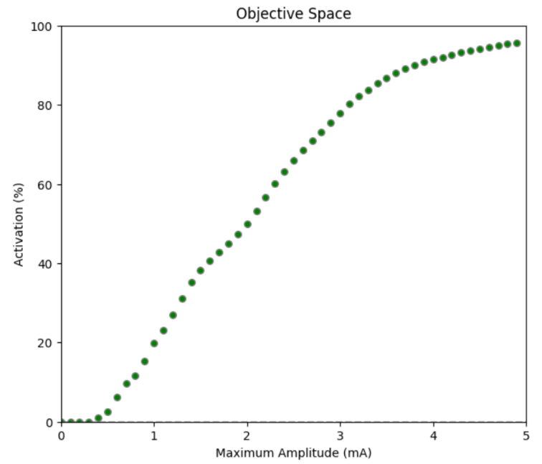
Evaluation
MetaModeling UX
MetaModeling UX - Setup
Pipeline Evaluation
Model:
Parameter sweep:
parameter 1 - Npoints:
parameter 2
…
Run parameter sweep:
similar to S4L, an icon in the bottom right allows to open the “running jobs” interface; and in the future, a view of all jobs in the database (with filters, etc)
Introducing the MetaModeling UX, Zürich, 2025

Slide 18
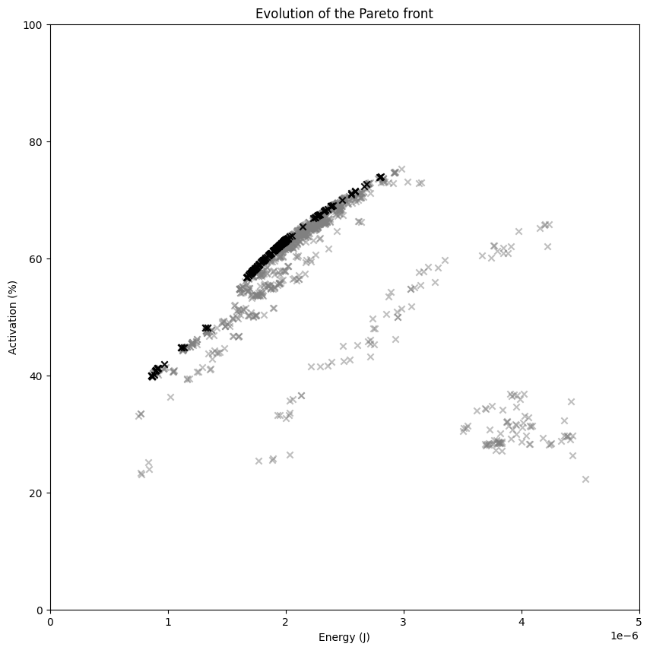
Example Applications: Optimization
Optimization
Algorithm:
Max Iterations: seed:
Parameters:
parameter 1 min: max:
…
Outputs:
QoI 1
MetaModeling UX
Introducing the MetaModeling UX, Zürich, 2025

Slide 19
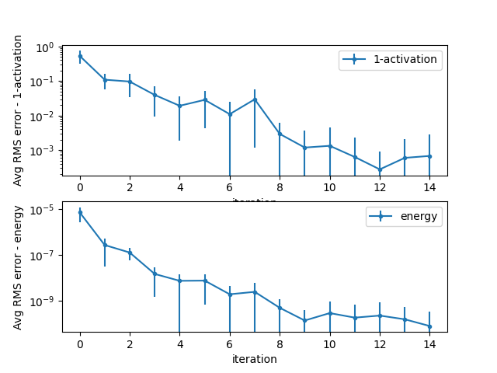
Example Applications: Surrogate-based Optimization
Surrogate-based Optimization
Algorithm:
Max Iterations: seed:
Parameters:
parameter 1 min: max:
…
Outputs:
QoI 1
MetaModeling UX
Introducing the MetaModeling UX, Zürich, 2025

Slide 20
Other Issues
Introducing the MetaModeling UX, Zürich, 2025
Introducing the MetaModeling UX, Zürich, 2025
Compliance Evaluations of Inductive WPT, Okinawa, 2024

Slide 21
Other issues
development timeline (e.g. what should be done & by when; work backwards from May release)
first prototype will be based on local execution (easy to export to in-service OSPARC execution)
will already use Werner’s API so no refactoring needed when OSPARC backend becomes available
don’t want users to skip SuMo inspection / validation; but registering each one is cumbersome. Assume log/ linear is same for all; and register all variables as a single function (containing N SuMos?)
multiple services (in App Mode) vs single service (with tabs emulating App Mode)
devs suggested to do everything in single service unless need / specific gains from multi-service
Werner has always expressed concern about how interactive services share information between them
Q: do we allow users to go back & forth, or are they fully linear workflows? If same step executed several times, might have synchrony issues (e.g. still using old results, etc). In a single service that is not an issue (state variables).
Niels wants all UIs visually unified by drawing from the same library of React components (JavaScript)
any way to make it Python-compatible? or need to learn front-end development?
Introducing the MetaModeling UX, Zürich, 2025

Slide 22
Conclusions
Introducing the MetaModeling UX, Zürich, 2025
Introducing the MetaModeling UX, Zürich, 2025
Compliance Evaluations of Inductive WPT, Okinawa, 2024

Slide 23

Conclusions
metamodeling UX can provide high-value insights & analytics to existing users
enhanced capabilities can support growth of user base
increased computational (simulation) revenues for ZMT & IT’IS
Introducing the MetaModeling UX, Zürich, 2025
Compliance Evaluations of Inductive WPT, Okinawa, 2024

